Slide 1
Eclipse Modeling Framework (EMF)
Paweł Żalejko

Slide 2

Agenda
Model-Driven Development
What is EMF?
EMF demo - hello world
EMF demo - command stack & adapters
EMF demo - data binding & validation
EMF demo - generating UI editors

Slide 3
Agenda
Model-Driven Development
What is EMF?
EMF demo - hello world
EMF demo - command stack & adapters
EMF demo - data binding & validation
EMF demo - generating UI editors

Slide 4
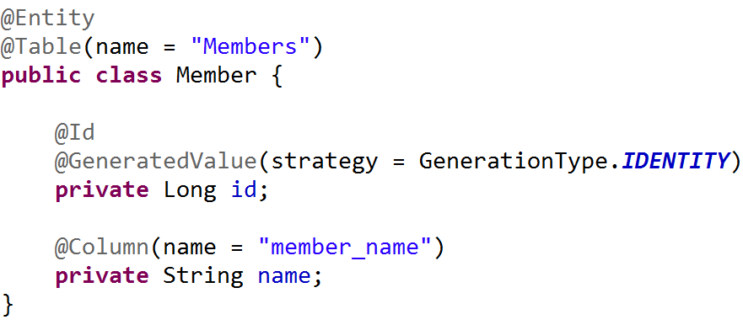
Model-Driven Development

Slide 5
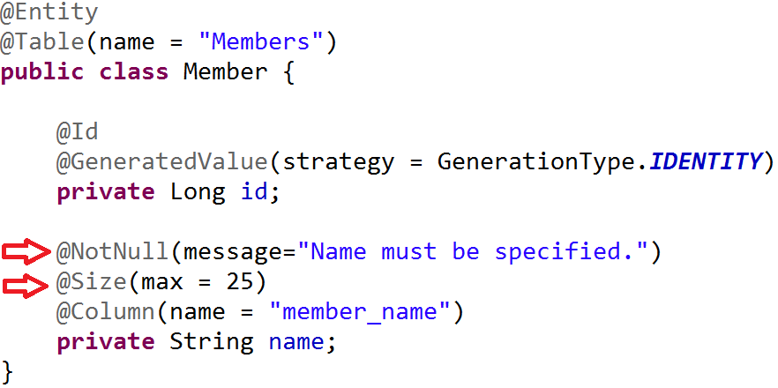
Model-Driven Development

Slide 6
Model-Driven Development
Clear visibility
Flexibility(models can be adjusted)
Fast & cost-effective
Leads to increased quality
Enforces architecture
Let’s programmers focus on the hard stuff

Slide 7
Agenda
Model-Driven Development
What is EMF?
EMF demo - hello world
EMF demo - command stack & adapters
EMF demo - data binding & validation
EMF demo - generating UI editors

Slide 8
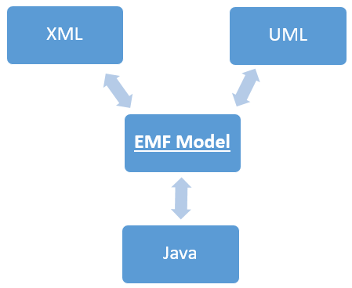
What is EMF?
Modeling framework
Code generator
Framework for building tools and applications based on a structured data model

Slide 9



EMF - frameworks
  Persistence
    CDO, EMFStore, Teneo
  UI frameworks
    EMF Forms
  Graphical Modeling
    GMF, Sirius
  Textual Modeling
    Xtext
  And much more...
    https://eclipse.org/modeling/

Slide 10
Agenda
Model-Driven Development
What is EMF?
EMF demo - hello world
EMF demo - command stack & adapters
EMF demo - data binding & validation
EMF demo - generating UI editors

Slide 11
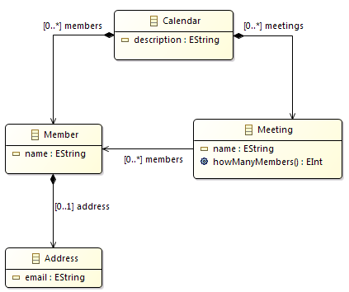


EMF demo - hello world
Create a model
  Eclipse Modeling IDE
  Create a new Ecore Modeling Project
Generate the code

Slide 12
EMF – ecore & genmodel
Two files:
  ecore - contains the information about the defined classes
  genmodel - contains information for the code generation

Slide 13
http://www.eclipse.org/emf/2002/GenModel
documentation
copyright
body
suppressedGetVisibility
suppressedSetVisibility
...

Slide 14
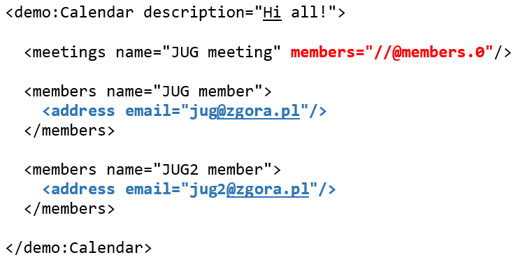
EMF – containment vs non containment

Slide 15
Object vs EObject
EObject is the root of all modeled objects
It provides support for the behaviors and features common to all modeled objects:
Reflection | Content
eClass eGet eSet ... | eResource eContainer eContents ...

Slide 16
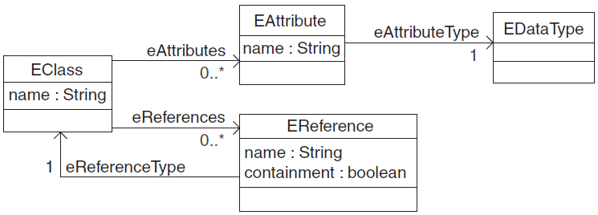
EMF – Ecore (Meta) Model
model of a model ☺:
  EClass
  EStructuralFeature
    EAttribute
    EReference
  EOperation
  EDataType

Slide 17
Agenda
Model-Driven Development
What is EMF?
EMF demo - hello world
EMF demo - command stack & adapters
EMF demo - data binding & validation
EMF demo - generating UI editors

Slide 18
EMF demo - command stack & adapters
Editing objects using commands
Undo/redo
Adapters as change listeners

Slide 19
Agenda
Model-Driven Development
What is EMF?
EMF demo - hello world
EMF demo - command stack & adapters
EMF demo - data binding & validation
EMF demo - generating UI editors

Slide 20
EMF demo - data binding & validation
Binding a model to UI controls
  DataBindingContext
  IObservableValue
  UpdateValueStrategy
Validating inputs
  Java
  Object Constraint Language (OCL)

Slide 21
Agenda
Model-Driven Development
What is EMF?
EMF demo - hello world
EMF demo - command stack & adapters
EMF demo - data binding & validation
EMF demo - generating UI editors

Slide 22
EMF demo - generating a UI editor
A simple form-based editor created using EMF Forms framework
UI:
  JavaFX
  SWT
  Eclipse RAP
http://www.eclipse.org/ecp/emfforms/

Slide 23
EMF demo - generating a Sirius-based editor
Sirius:
„Sirius is an Eclipse project which allows you to easily create your own graphical
modeling workbench by leveraging the Eclipse Modeling technologies, including EMF and GMF.”
https://eclipse.org/sirius/overview.html

Slide 24

Thanks!
    https://eclipse.org/modeling/
https://eclipse.org/modeling/emf/
http://www.eclipse.org/modeling/emf/docs/
http://www.eclipse.org/ecp/emfforms/
https://eclipse.org/sirius/overview.html

